Slide 1
MATLAB Basics (II)
施心慧
中国海洋大学数学学院

Slide 2
Plotting
Plotting 2-D curves（曲线）
Plotting 3-D curves or surfaces（曲面）

Slide 3
plotting
plotting 2-D curves
under a Cartesian Coordinate System
(笛卡尔（直角）坐标系)
plot
contour—等值线
under a Polar Coordinate System（极坐标系）
polar

Slide 4

Plotting 2-D Curves Under A Cartesian Coordinate System
Basic Form for one curve:
x=…;
y=…;
plot (x, y)
Some variations
plot (x, y,’r’)
plot(x, y, ‘g.-’)

Slide 5
Plotting 2-D Curves Under A Cartesian Coordinate System
Basic Form for two curves: (1)
x1=…;
x2=…;
y1=…;
y2=…;
plot(x1,y1);
hold on;
plot(x2,y2);
hold off
The second curve is in the same window as the first one.

Slide 6
Plotting 2-D Curves Under A Cartesian Coordinate System
Basic Form for two curves: (2)
x1=…;x2=;
y1=…;
y2=…;
plot(x1,y1,x2,y2);
or
plot(x1,y1,’m’,x2,y2,’b’);

Slide 7
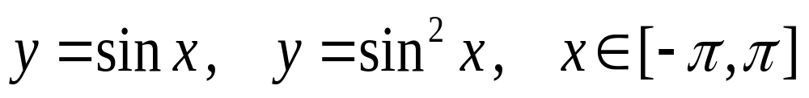
Plotting 2-D Curves Under A Cartesian Coordinate System
Example:
Plot the following two curves in a same coordinate system

Slide 8
Plotting 2-D Curves Under A Polar Coordinate System
Basic Form:
theta=…; %极角构成的向量
r=…;%极径构成的向量
polar (theta,r)
or
polar (theta, r,’g’)

Slide 9
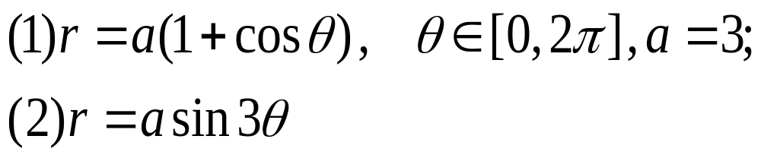
Plotting 2-D Curves Under A Polar Coordinate System
Example: Plot the curves in polar coordinates:

Slide 10
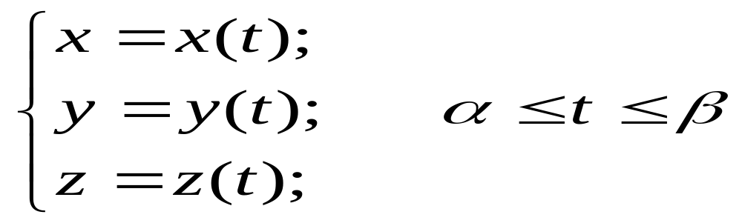
Plotting 3-D Curves Under A Cartesian Coordinate System
Basic Form:
t=…;
x=…;y=…;z=…;
plot3(x,y,z)
The curve equation should be written in parametric form:

Slide 11
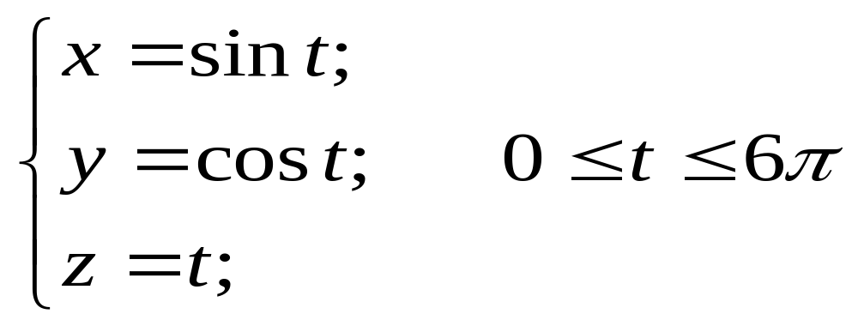
Plotting 3-D Curves Under A Cartesian Coordinate System
Plot the 3-D curves:

Slide 12
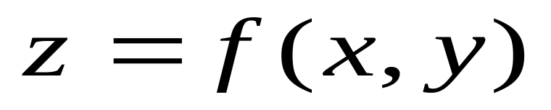
Plotting 3-D Surfaces Under A Cartesian Coordinate System
Basic Form:
x=…;
y=…;
[X,Y]=meshgrid(x,y);
Z=f(X,Y);
mesh(X,Y,Z)( or surf, contour3)
The surface equation should be written as follows:

Slide 13
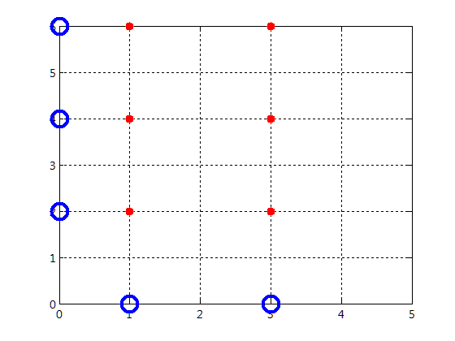
How to use meshgrid
x=1:2:4
y=2:2:6
[X,Y]=meshgrid(x,y)
X =
1 3
1 3
1 3
Y =
2 2
4 4
6 6

